Slide 2

LMS System
Khoa Nguyen

Slide 3

Agenda
Mind map
Use Case Diagram
UX UI Design / Database
Q&A

Slide 4
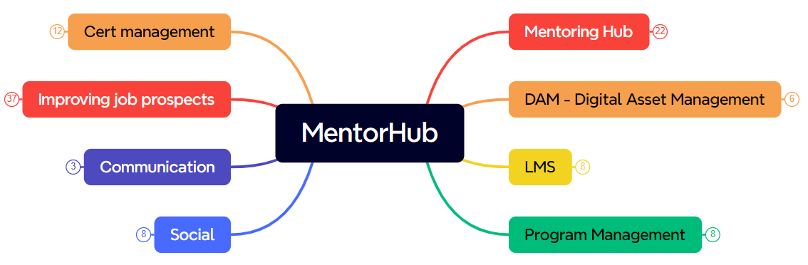
Mentor Hub

Slide 5
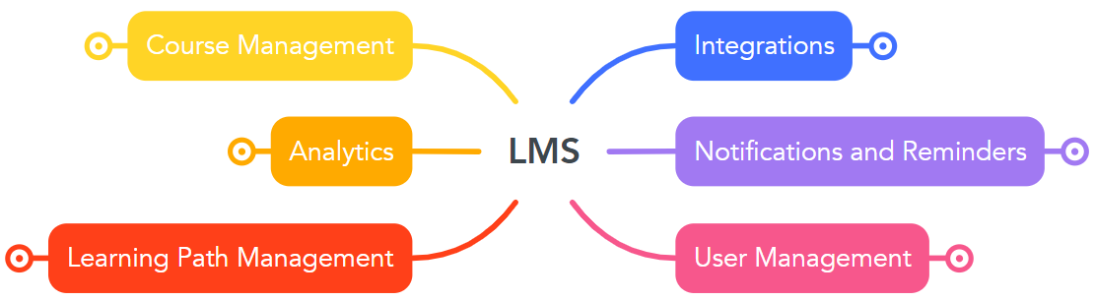
LMS

Slide 6
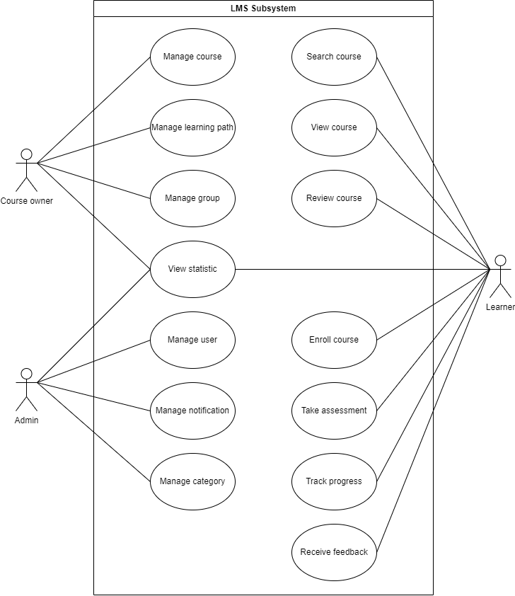
Use Case

Slide 7
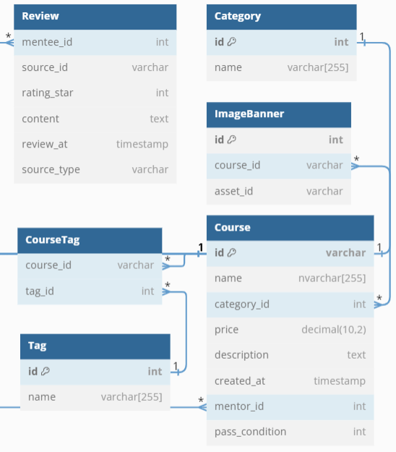

Mentee - Course Listing
Notes:
Popular Course: SELECT course_id, COUNT(mentee_id) AS num_enrolled, course.name AS course_name, course.price, category.name AS categoryFROM menteecourse JOIN course ON menteecourse.course_id = course.id JOIN category ON course.category_id = category.idGROUP BY course_idORDER BY num_enrolled DESC LIMIT 4;
Trending Course: SELECT course.name AS courseName, course.price, course.description, category.name AS category, course.created_at, rate.avg_rate, rate.total_rateFROM course JOIN category ON course.category_id = category.id JOIN (SELECT course_id FROM menteecourse GROUP BY course_id ORDER BY COUNT(course_id) DESC LIMIT 4) AS trending ON course.id = trending.course_id JOIN (SELECT COUNT(review.rating_star) AS total_rate, SUM(review.rating_star) / COUNT(review.rating_star) AS avg_rate, course.id FROM review JOIN course ON review.source_id = course.id GROUP BY course.id) AS rate ON course.id = rate.idORDER BY rate.avg_rate DESC;
SELECT COUNT(course_id) AS num_enroll, course_id, category_idFROM course c JOIN menteecourse m ON c.id = m.course_idGROUP BY category_id , course_idHAVING category_id IN (SELECT category_id FROM favouritecategory WHERE mentee_id = 7)

Slide 8

Mentee - Course Listing

Slide 9
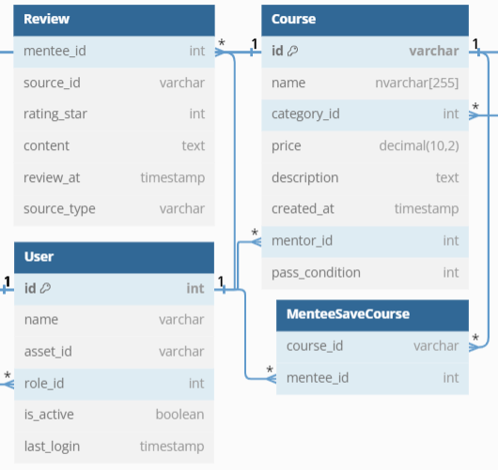

Mentee - Course Details
Notes:
Course Details: WITH lesson_count as (SELECT s.id, s.course_id, s.name, COUNT(l.id) AS lesson_per_sectionFROM section s JOIN lesson l ON s.id = l.section_idGROUP BY s.id , s.name),section_count as (SELECT course_id, SUM(lesson_per_section) AS total_lesson, COUNT(lesson_per_section) AS total_sectionFROM lesson_countGROUP BY course_id),review_count as (SELECT source_id, COUNT(source_id) AS total_review, AVG(rating_star) AS avg_starFROM lms.reviewGROUP BY source_id)SELECT c.name, c.price, u.name, u.asset_id, c.description, s.total_lesson, s.total_section, r.total_review, round(r.avg_star, 1) as avg_starFROM lms.course c JOIN user u ON c.mentor_id = u.id JOIN section_count s ON c.id = s.course_id JOIN review_count r on c.id = r.source_id WHERE c.id = 'C1'

Slide 10
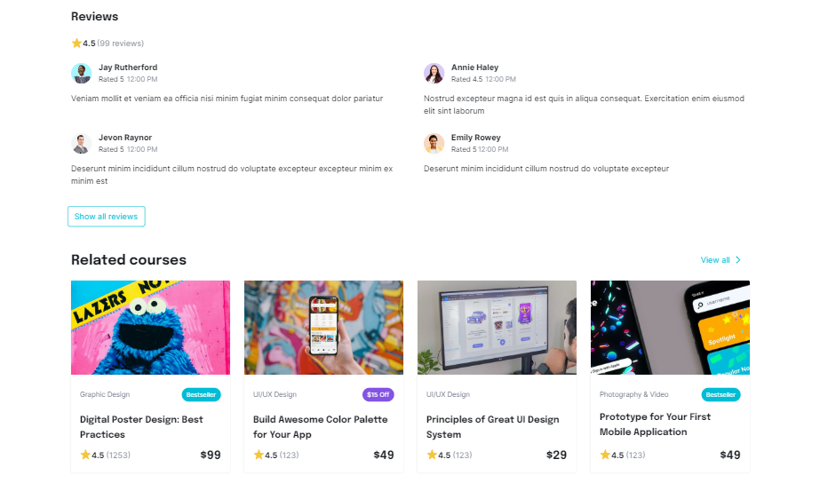
Mentee - Course Details

Slide 11
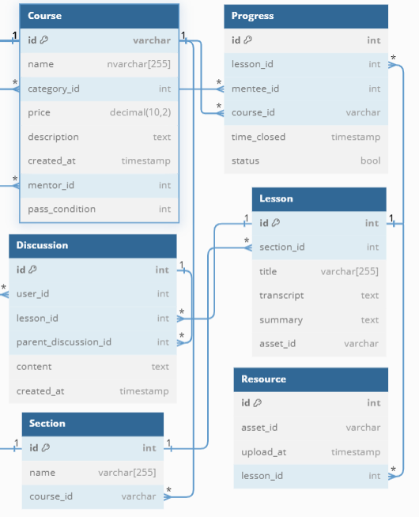

Study and discuss
Notes:
SELECT l.id, title, transcript, summary, l.asset_id, u.name, d.contentFROM lms.lesson l JOIN discussion d ON l.id = d.lesson_id JOIN user u ON u.id = d.user_idWHERE l.id = 2;
SELECT name AS section_name, l.id, titleFROM lms.section s JOIN lesson l ON s.id = l.section_idWHERE s.id = 1;

Slide 12
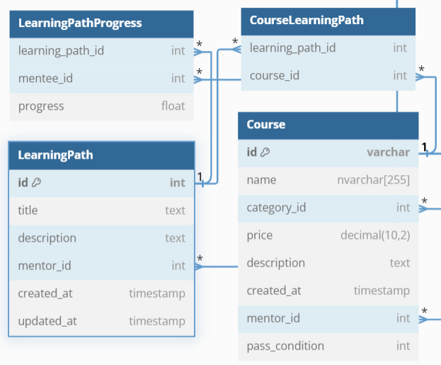

Mentee - Learning path
Notes:
SELECT title, description , u.name, l.created_at FROM lms.learningpath l join user u on l.mentor_id = u.id;

Slide 13
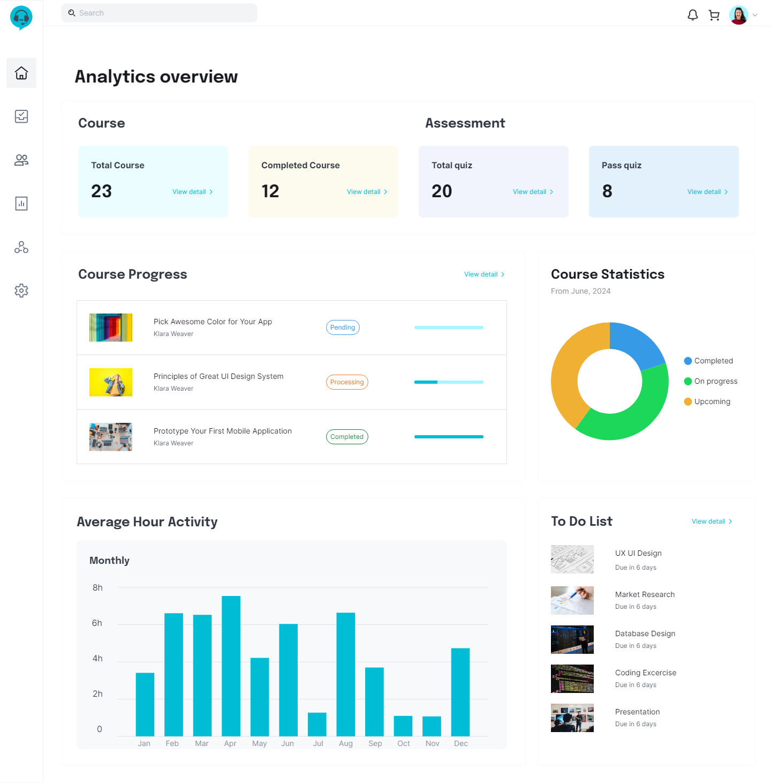
Mentee - Dashboard
Notes:
SELECT count(*) as total_course FROM lms.menteecourse where mentee_id = 11;
SELECT count(*) as complete_course FROM menteecourse where mentee_id = 11 and cert_id is not null;
SELECT count(*) as total_quiz FROM quizresult where mentee_id = 11;
SELECT count(*) as pass_quiz FROM quizresult where mentee_id = 11 and result = 1;
SELECT course_id, progress, name, CASE WHEN progress = 0 THEN 'Pending' WHEN progress < 100 THEN 'Processing' ELSE 'Completed' END AS tag FROM menteecourse me JOIN course c ON me.course_id = c.id WHERE mentee_id = 11;
SELECT status, ROUND((COUNT(*) * 100.0 / total_courses), 2) AS percentageFROM ( SELECT CASE WHEN progress = 0 THEN 'Pending' WHEN progress < 100 THEN 'Processing' ELSE 'Completed' END AS status, COUNT(*) OVER() AS total_courses FROM menteecourse me JOIN course c ON me.course_id = c.id WHERE mentee_id = 11) subqueryGROUP BY status, total_courses;
SELECT sum(online_time), month(online_date) as monthly FROM lms.online where user_id = 7 group by month(online_date);
SELECT s.name as section_name, q.name as quiz_name FROM lms.menteecourse mc join section s on mc.course_id = s.course_id join quiz q on s.id = q.section_id where mentee_id = 11 and q.id not in (SELECT quiz_id FROM quizresult where mentee_id = 11 and result is true);

Slide 14
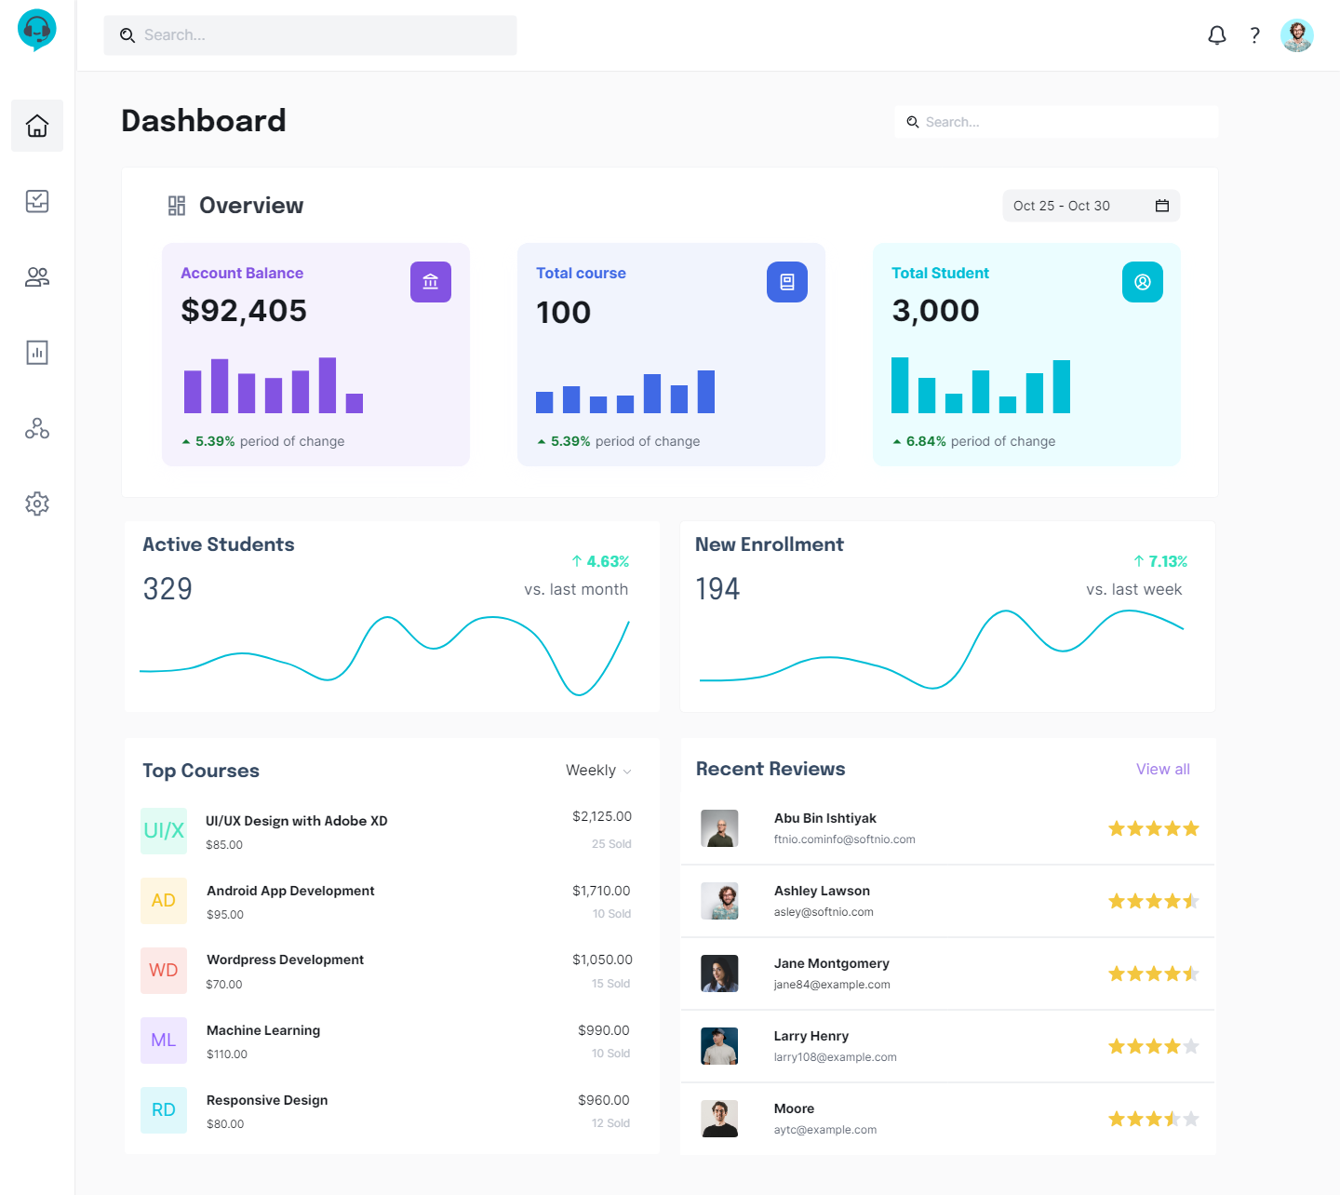
Mentor - dashboard
Notes:
SELECT SUM(price) AS revenueFROM course c JOIN menteecourse mc ON c.id = mc.course_id AND mentor_id = 2;
SELECT COUNT(id) total_courseFROM courseWHERE mentor_id = 2;
SELECT count(distinct mentee_id) AS total_studentFROM course c JOIN menteecourse mc ON c.id = mc.course_id AND mentor_id = 2;
SELECT COUNT(u.id)FROM course c JOIN menteecourse mc ON c.id = mc.course_id JOIN user u ON mc.mentee_id = u.idWHERE u.is_active IS TRUE;
SELECT COUNT(*) AS new_enrollmentFROM course c JOIN menteecourse mc ON c.id = mc.course_idWHERE DATEDIFF(CURRENT_TIMESTAMP, enroll_at) < 7 AND mentor_id = 2;
SELECT c.name, SUM(price) AS revenue, COUNT(*) AS quantityFROM course c JOIN menteecourse mc ON c.id = mc.course_idWHERE mentor_id = 2GROUP BY c.nameORDER BY revenue;
SELECT rating_star, u.nameFROM review r JOIN course c ON source_id = c.id AND c.mentor_id = 2 JOIN user u ON r.mentee_id = u.idORDER BY r.review_at DESCLIMIT 5

Slide 15
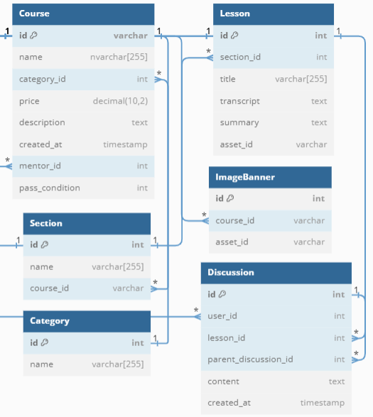
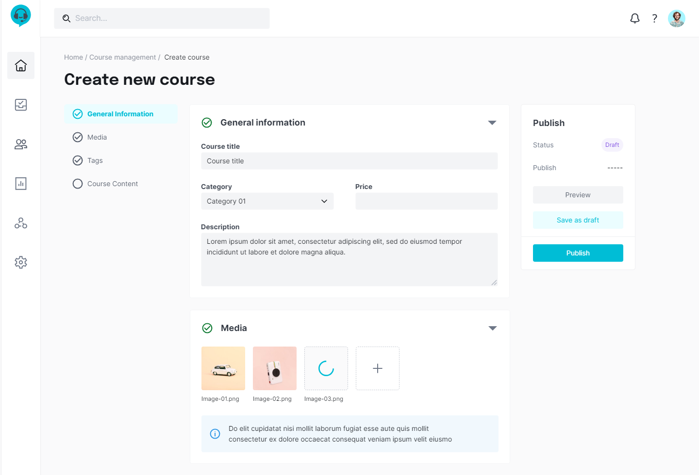
Mentor create course
Notes:
SELECT name from tag;
SELECT name FROM category;
SELECT course_id, asset_idFROM imagebanner

Slide 16
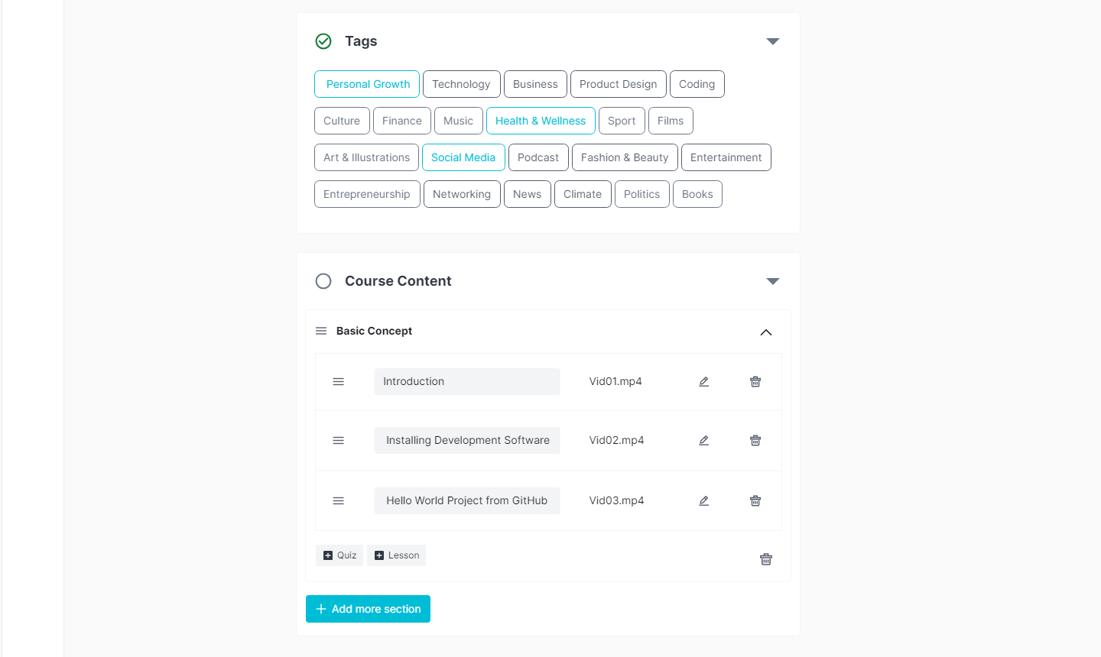
Mentor create course

Slide 17
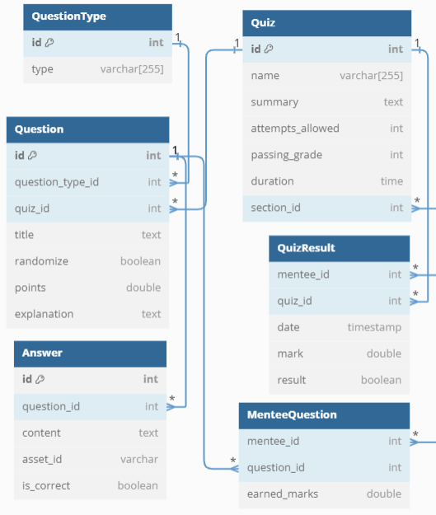
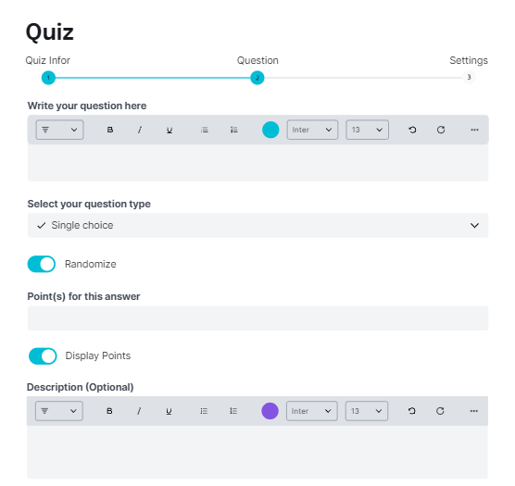
Mentor – create section quiz
Notes:
SELECT name, summary, attempts_allowed, passing_grade, duration FROM quiz;
SELECT type FROM questiontype;

Slide 18
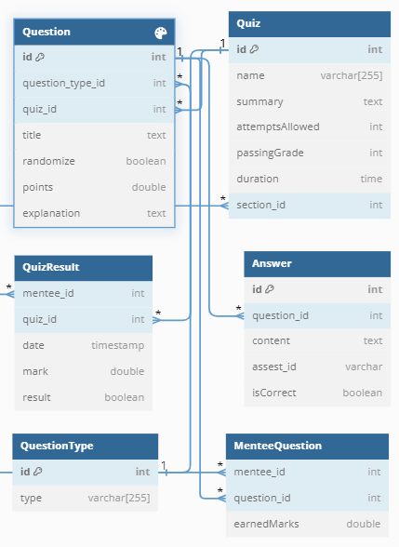
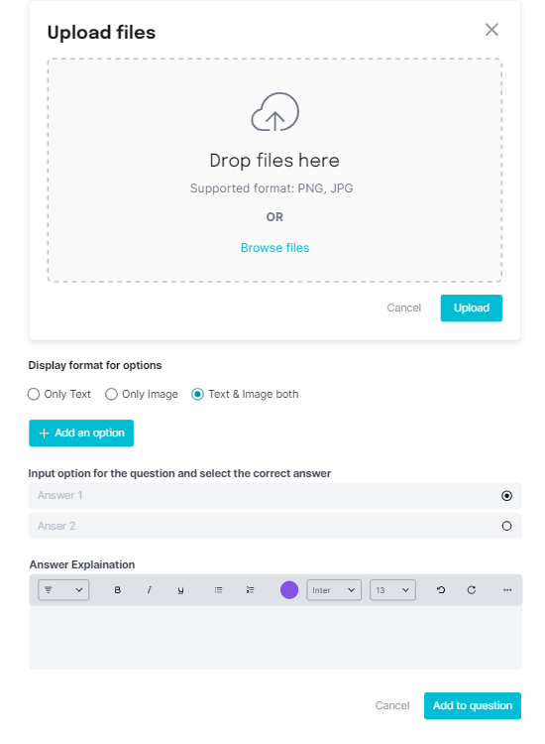
Mentor – create section quiz
Notes:
SELECT content, asset_id, is_correct FROM answer;

Slide 19
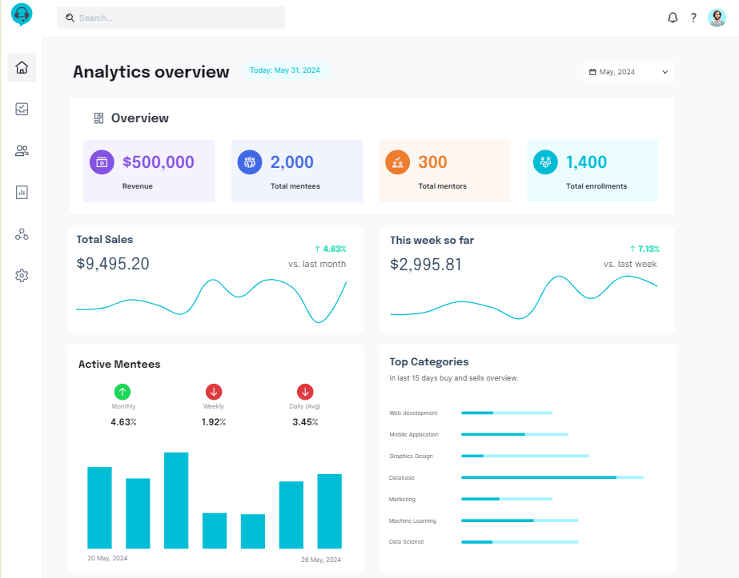
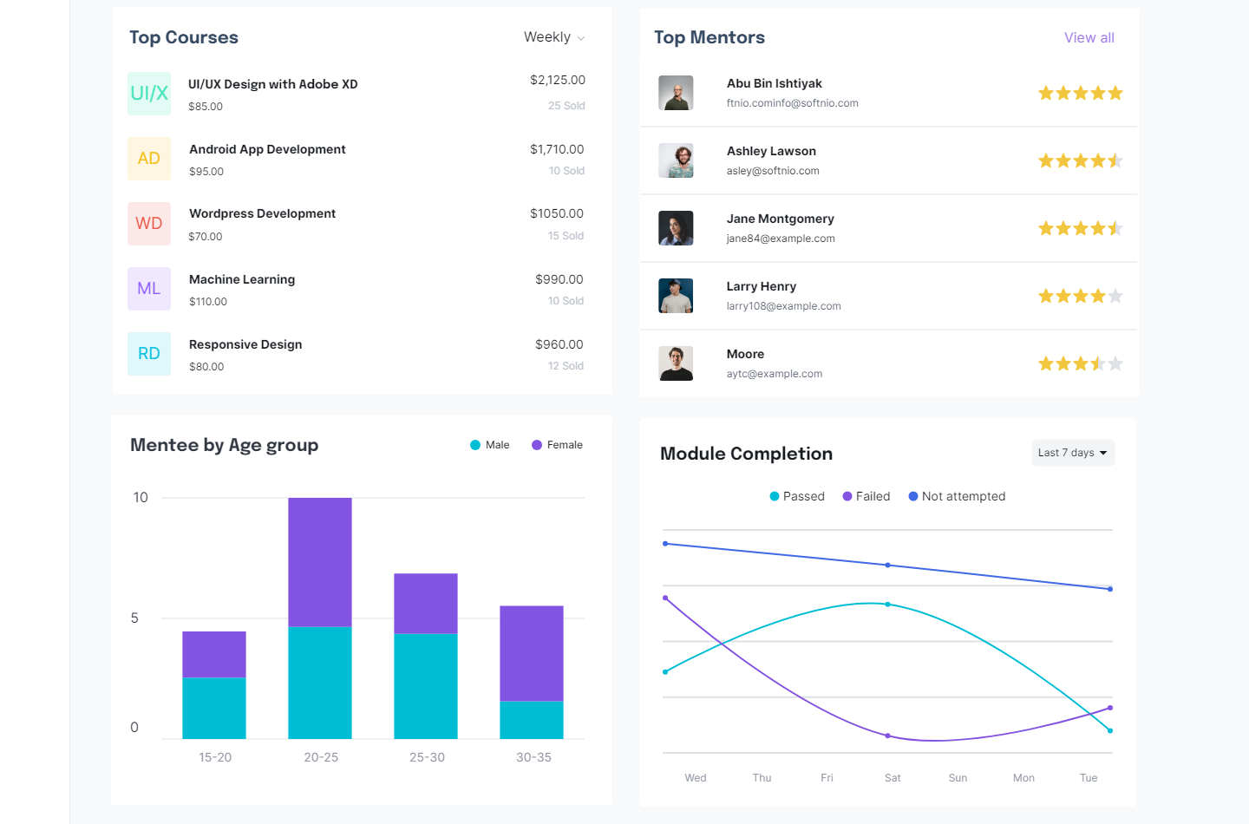
Admin - dashboard
Notes:
SELECT sum(price) as total_revenue FROM lms.menteecourse me join course c on me.course_id = c.id;
SELECT COUNT(*) as total_memtor FROM user where role = 2;
SELECT COUNT(*) as total_memtee FROM user where role = 3;
SELECT COUNT(*) AS total_enrollmentFROM menteecourseWHERE enroll_at IS NOT NULL;
SELECT SUM(price) AS monthly_saleFROM course c JOIN menteecourse mc ON c.id = mc.course_idWHERE MONTH(mc.enroll_at) = MONTH(CURRENT_TIMESTAMP);
SELECT SUM(price) AS weeekly_saleFROM course c JOIN menteecourse mc ON c.id = mc.course_idWHERE WEEK(mc.enroll_at) = WEEK(CURRENT_TIMESTAMP);
with cte as (SELECT DATE(online_time) AS onl_date, ROUND(HOUR(online_time) + MINUTE(online_time) / 60, 2) AS onl_timeFROM `online`)SELECT onl_date, SUM(onl_time) AS total_timeFROM cteGROUP BY onl_date;
with 15_day_sell as (SELECT COUNT(*) AS total_sells, category_idFROM courseWHERE DATEDIFF(created_at, CURRENT_TIMESTAMP) < 15GROUP BY category_id),15_day_buy as (SELECT COUNT(course_id) AS total_buy, category_idFROM course c JOIN menteecourse m ON c.id = m.course_idGROUP BY category_id)SELECT total_sells, total_buy, category.nameFROM 15_day_sell AS sell JOIN 15_day_buy AS buy ON sell.category_id = buy.category_id JOIN category ON sell.category_id = category.id;
with rating as (SELECT avg(rating_star) as average_star, mentor_id FROM lms.review r join course c on r.source_id = c.idgroup by mentor_id)select average_star, c.mentor_id, count(c.mentor_id) as enroll_per_mentor from course c join menteecourse m on c.id = m.course_idjoin rating on c.mentor_id = rating.mentor_idgroup by mentor_id;
select count(course_id) as enroll_num, c.name, c.price, sum(c.price) as total_sale from menteecourse m join course c on m.course_id = c.id where datediff(m.enroll_at, current_timestamp) <=7group by c.name, c.price limit 5

Slide 20
Question and Answer

Slide 21
Thanks for watching

